Slide 1
Antibiotics
By
Ahmed Radwan
Lecturer of Tropical Medicine & Gastroenterology
Faculty of Medicine, Assiut University

Slide 2
What is an Antimicrobial (Antibiotic)?
“Antibiotic” is from antibiosis, meaning against life.
Substances derived from a microorganism or produced synthetically (Sulfonamides and Quinolones) to kill or suppress the growth of other microorganisms.

Slide 3
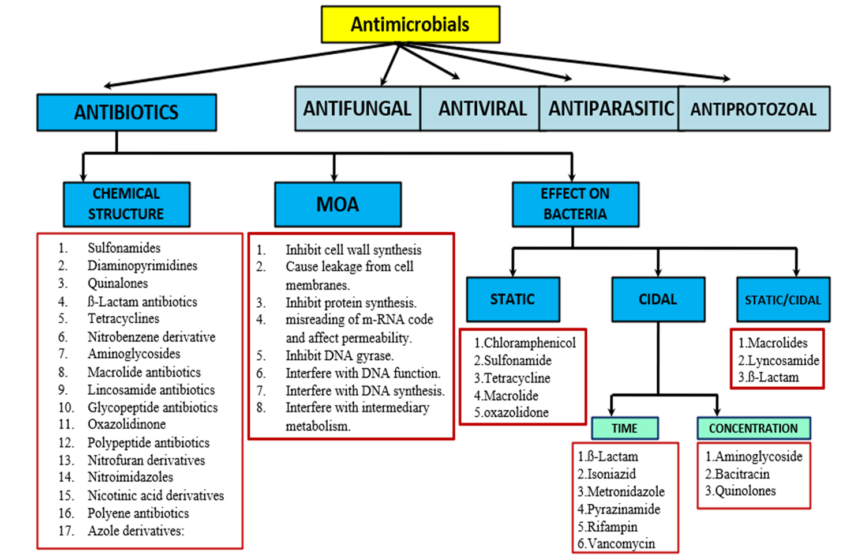

Slide 4
Classification of Antibiotics
Antibiotics are classified by several ways:
On the basis of mode of action
On the basis of spectrum of activity
On the basis of mechanism of action

Slide 5
On the basis of mode of action
Inhibit growth of susceptible bacteria, rather than killing them immediately; will eventually lead to bacterial death
e.g. Tetracycline, Chloramphenicol, Erythromycin & Lincomycin
Bacteriostatic antibiotics:
Bactericidal antibiotics:
Kill bacteria
e.g. Cephalosporin, Penicillin, Erythromycin, Aminoglycosides & Cotrimoxazole

Slide 6
Antimicrobial Spectrum
Antimicrobial spectrum: the scope that a drug kills or suppresses the growth of microorganisms.
Narrow-spectrum: The drugs that only act on Small range (one strain of bacteria), e.g Isoniazide, Macrolids, Lincosamide, Glycopeptides)
Broad-spectrum: The drugs that have a wide antimicrobial scope.(Pencillins, Carbapenems, Tetracycline, Chloramphenicol)

Slide 7
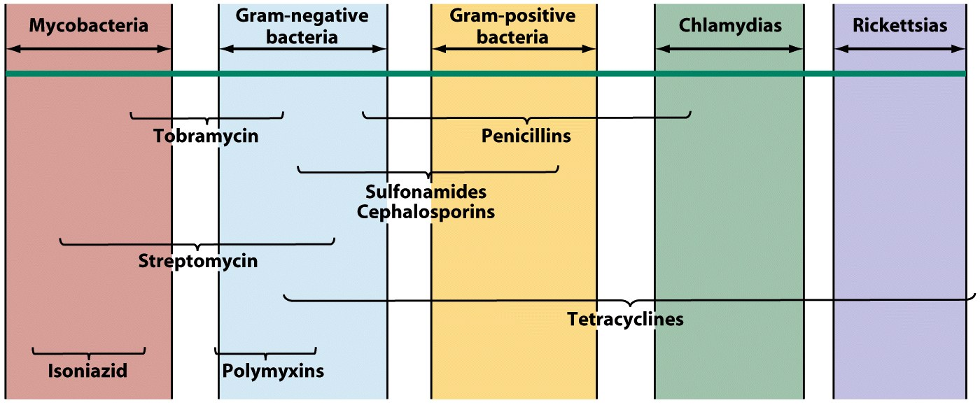
On the basis of spectrum of activity

Slide 8
Mechanism of action of antimicrobial agents
1. Inhibition of cell wall synthesis:
2. Inhibition of functions of cellular membrane:
Polymyxins
3. Inhibition of protein synthesis:
Chloramphenicol, Macrolides & Clindamycin
Tetracyclines & Aminoglycosides
Penicillins, Cephalosporins, Bacitracin & Vancomycin

Slide 9
Mechanism of action of antimicrobial agents
4. Inhibition of nucleic acid synthesis:
Inhibition of RNA synthesis: Quinolones
Inhibition of RNA synthesis: Rifampin
5. Inhibition of folic acid synthesis:
Sulfonamides & trimethoprim

Slide 10
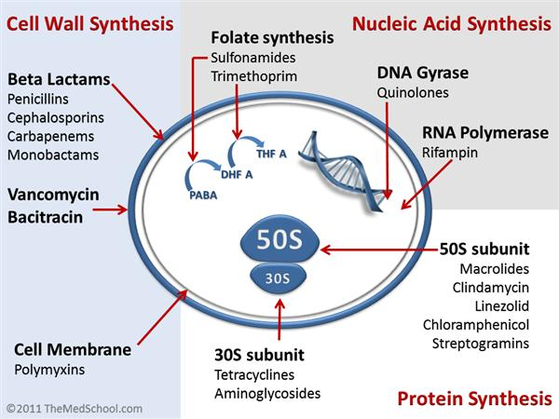
On the basis of mechanism of action

Slide 11
Misuse of Antibiotics
Antibiotic misuse, sometimes called antibiotic abuse or antibiotic overuse
The misuse or overuse of antibiotics, may produce serious effects on health.
It is a contributing factor to the creation of multidrug-resistant bacteria, informally called “super bugs”.

Slide 12
Antibiotic Resistances and Cross Resistances
Antibiotic resistance is the phenomenon that
susceptibility of pathogenic microorganisms
to antibiotic becomes lower or even loses after
the microorganisms contact with antibiotic many
times.
When the bacteria show resistance to one
antibiotic, they are also resistant to some other
antibiotics. This phenomenon is called cross
antibiotic resistance.

Slide 13
Mechanisms of Antibiotic Resistance
1. Alteration of the target site of the antibiotic
One of the most problematic antibiotic resistances worldwide, methicillin resistance among Staphylococcus aureus.
2. Enzyme inactivation of the antibiotic
β-lactam antibiotics (Penicillins & Cephalosporins) can be inactivated by β-lactamases.

Slide 14
Mechanisms of Antibiotic Resistance
Cont.
3. Active transport of the antibiotic out of the bacterial cell
Active transport of the antibiotic out of the bacterial cell (efflux pumps) as removal of some antibiotics e.g. Tetracyclines, Macrolides, & Quinolones
4. Decreased permeability of the bacterial cell wall to the antibiotic
Alteration in the porin proteins that form channels in the cell membrane e.g. Resistance of Pseudomonas aeruginosa to a variety of Penicillins & Cephalosporins

Slide 15
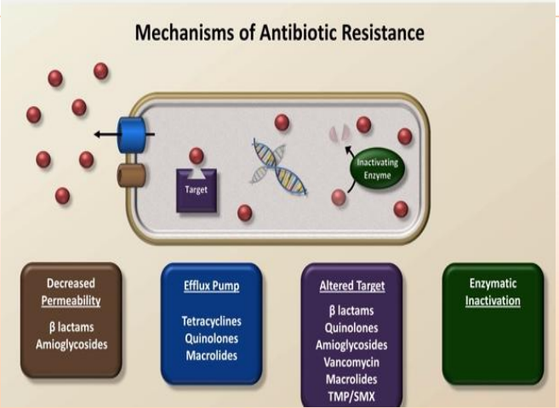

Slide 16
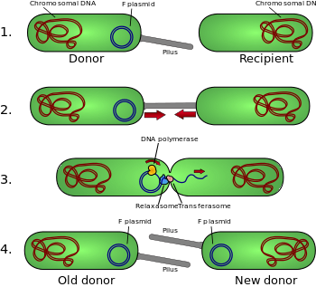
Conjugation

Slide 17
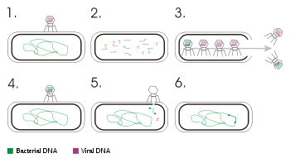
Transduction(bacterophage)

Slide 18
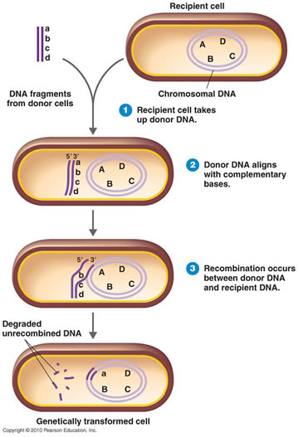
Transformation

Slide 19
General Principles of Antimicrobial Therapy
Identification of the infecting organism should precede antimicrobial therapy when possible.
The pathogenic microorganism susceptibility to antimicrobial agents should be determined, if a suitable test exists.
Factors that influence the choice of an antimicrobial agent or its dosage for a patient include the age, renal and hepatic function, pregnancy status, and the site of infection, etc.

Slide 20
Selection of Antimicrobial Agent
Empiric therapy - prior to identification of Organism - critically ill patients
Organism’s susceptibility to the antibiotic
Patient factors - immune system, renal/hepatic function
Effect of site of infection on therapy - blood brain barrier
Safety of the agent
Cost of therapy

Slide 21
Complications of Antibiotic Therapy
Resistance due to inappropriate use of antibiotics
Hypersensitivity (Penicillin)
Direct toxicity (Aminoglycosides = ototoxicity)
Super infections (broad spectrum antimicrobials cause alteration of the normal flora; often difficult to treat)

Slide 22
Antimicrobial Combination
Results of Combination Therapy:
Additive (indifferent) effect: the activity of two drugs in combination is equal to the sum (or a partial sum) of their independent activity when studied separately.
Synergistic effect: the activity of two drugs in combination is greater to the sum of their independent activity when studied separately.
Antagonistic effect: the activity of two drugs in combination is less to the sum (or a partial sum) of their independent activity when studied separately.

Slide 23
Indications for the Clinical Use of Antimicrobial Combinations
Prevention of the emergence of resistant organisms
Polymicrobial infection
Initial therapy
Decreased toxicity
Synergism

Slide 24
Prevention of the Emergence of Resistant Organisms
Decreased resistant mycobacterium tuberculosis with combination
Reduction of β-lactamase induction with combination β-lactam agents and Aminoglycosides

Slide 25
Polymicrobial Infection
Intra-abdominal infection
Pelvic infection
Mixed aerobic and anaerobic organism

Slide 26
Initial Therapy
Neutropenic patients
In patients where the nature of infection is not clear yet

Slide 27
Decreased Toxicity
Decrease the toxic drug required for treatment and thus reduce the dose related toxicity

Slide 28
Synergism
Enhanced Uptake of Aminoglycosides when Combined with β-lactam agents
Treatment of enterococcal endocarditis: ampicillin & gentamicin
Viridans streptococcal endocarditis: penicillin & gentamicin
Staphylococcal bacteremia: vancomycin & gentamicin
Treatment of pseudomonas infections: β-lactam agent & Aminoglycosides

Slide 29
Inhibition of Sequential Steps
Sulfonamide with trimethoprim
Treatment and prevention of chronic urinary tract infection, typhoid fever, shigellosis caused by organisms resistant to ampicillin
Inhibition of enzymatic activation

Slide 30
Disadvantages of the Inappropriate Use of Antimicrobial Combination
Antagonism
Increased cost
Adverse effects
Super infections (alteration of the normal flora; often difficult to treat)

Slide 31
Take a long breath…

Slide 32
Classes of Antibiotics
The main classes of antibiotics are:
Beta-Lactams
  Penicillins
  Cephalosporins
  Carbapenems
  Monobactams
Macrolides & Ketolides
Aminoglycosides
Fluoroquinolones
Tetracyclines, Amphenicols

Slide 33
Penicillins
The penicillins are the oldest class of antibiotics. Penicillins have a common chemical structure which they share with the Cephalosporins.
Penicillins are generally bactericidal, inhibiting formation of the cell wall. Penicillins are used to treat skin infections, dental infections, ear infections, respiratory tract infections, urinary tract infections, gonorrhea.

Slide 34
Types of penicillins
The natural penicillins
Benzylpenicillin (Penicillin G), Procaine Benzylpenicillin, Benzathine penicillin & Penicillin V
Penicillinase-resistant penicillins
Methicillin & Oxacillin, flucloxacillin
Aminopenicillins
Ampicillin & Amoxicillin

Slide 35
Types of penicillins
Ureidopenicillins (long acting)
Piperacillin
Penicillins/Beta-lactamase inhibitors
Ampicillin/sulbactam, Amoxicillin/clavulanic, Piperacillin/tazobactam

Slide 36
Cephalosporins
1st generation | 2nd generation | 3rd generation | 4th generation | 5th generation
Cephradine Cephalexin Cefadroxil Cefazolin | Cefoxitin Cefotetan Cefaclor Cefuroxime | Ceftazidime Cefixime Cefoperazone Cefotaxime Ceftriaxone Cefdinir Ceftibuten | Cefepime Cefpirome | Ceftaroline Ceftobiprole

Slide 37
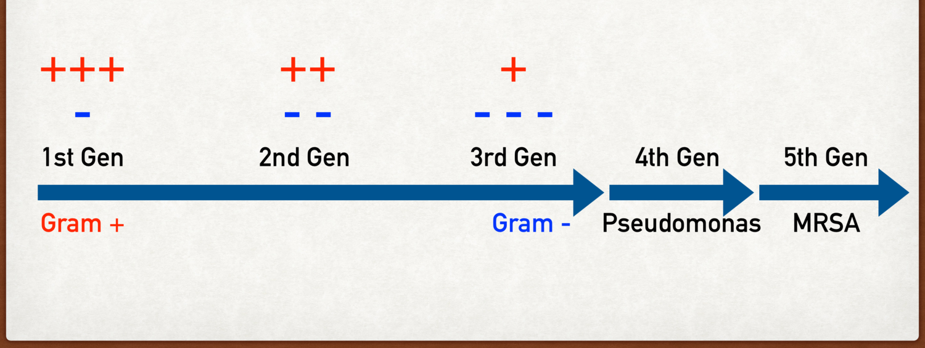
Spectrum of Cephalosporins

Slide 38
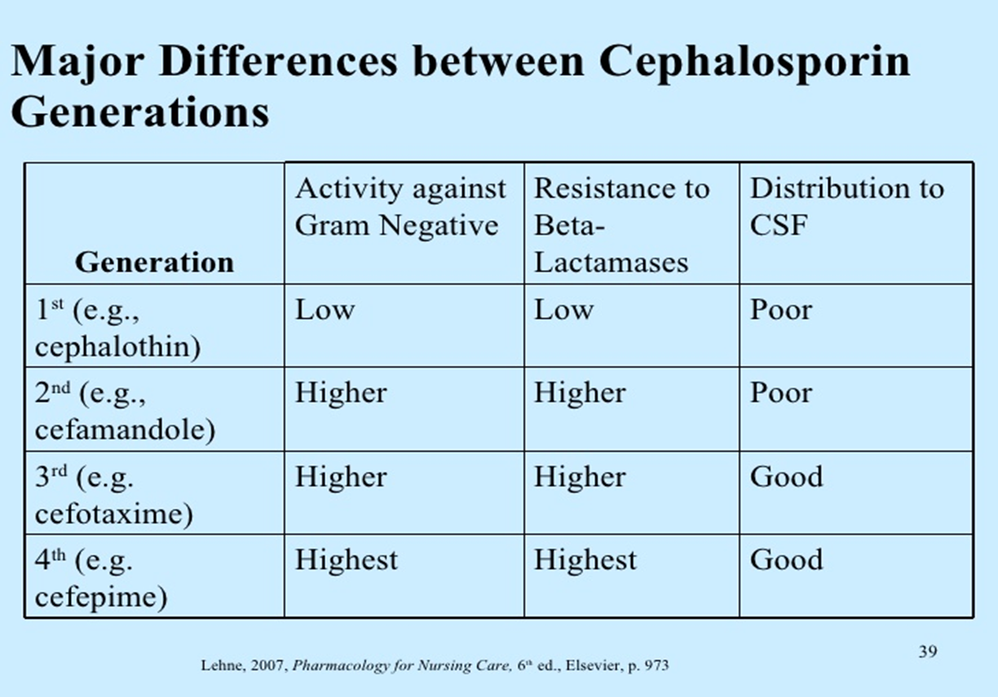

Slide 39
Carbapenems
a class of β-Lactam antibiotics with a broad spectrum of antibacterial activity
Highly resistant to most β-lactamases
Active against both Gram-positive and Gram-negative bacteria, and anaerobes, with the exception of intracellular bacteria (atypical), such as the Chlamydia.
Agents:
Imipenem/Cilastatin (Tienem)
  Meropenem (Meronem)
  Ertapenem

Slide 40
Monobactams
They are β-lactam compounds
They work only against aerobic Gram negative bacteria (Neisseria, Pseudomonas).
The only commercially available Monobactams antibiotic is Aztreonam (Azactam).
Adverse effects to Monobactams can include skin rash and occasional abnormal liver functions.

Slide 41
Glycopeptides
Glycopeptides (e.g. vancomycin, teicoplanin)
These antibiotics are effective principally against Gram-positive cocci.
This class of drugs inhibit the synthesis of cell walls in susceptible microbes by inhibiting peptidoglycan synthesis.
Vancomycin is used if infection with methicillin-resistant Staphylococcus aureus (MRSA) is suspected.

Slide 42
Due to their toxicity, use of glycopeptides antibiotics is restricted to patients who are critically ill, who have a demonstrated hypersensitivity to the β-lactams, or who are infected with β-lactam-resistant species.
They exhibit a narrow spectrum of action and are bactericidal only against the enterococci.
Some tissues are not penetrated very well by glycopeptides and they do not penetrate into the cerebrospinal fluid.

Slide 43
Oral preparations of vancomycin are available, however they are not absorbed from the lumen of the gut, formulated for the treatment of infections within the gastrointestinal tract, Clostridium difficile, for example.

Slide 44
Macrolides
The Macrolides are bacteriostatic, binding with bacterial ribosomes to inhibit protein synthesis.
Macrolides antibiotics are used to treat respiratory tract infections (such as pharyngitis, sinusitis, and bronchitis), genital, gastrointestinal tract, and skin infections.
Macrolides antibiotics are:
Erythromycin (Erythrocin)
Clarithromycin (Klacid)
Azithromycin (Zithromax)
Roxithromycin (Roxicin)

Slide 45
Ketolides
Antibiotics belonging to the Macrolides group
Much broader spectrum than other Macrolides.
Ketolides are effective against Macrolides-resistant bacteria, due to their ability to bind at two sites at the bacterial ribosome as well as having a structural modification that makes them poor substrates for efflux-pump mediated resistance.
The only Ketolide on the market at this moment is telithromycin, which is sold under the brand name of Ketek.

Slide 46
Lincosamides
Lincosamides (e.g. lincomycin, clindamycin) are a class of antibiotics.
Lincosamides prevent bacteria replicating by interfering with the synthesis of proteins.

Slide 47
They are normally used to treat staphylococci and streptococci, and have proved useful in treating Bacteroides fragilis and some other anaerobes.
They are used in the treatment of Toxic Shock Syndrome.
Lincosamides antibiotics are one of the classes of antibiotics most associated with pseudomembranous colitis caused by C. difficile.

Slide 48
Aminoglycosides
Aminoglycosides antibiotics are used to treat infections caused by Gram-negative bacteria.
Aminoglycosides may be used along with penicillins or cephalosporins to give a two-pronged attack on the bacteria.
Since Aminoglycosides are broken down easily in the stomach, they can't be given by mouth and must be injected.

Slide 49
Generally, Aminoglycosides are given for short time periods.
Aminoglycosides group includes:
Amikacin (Amikin)
Gentamicin (Garamycin)
Neomycin (Neomycin)
Streptomycin (Streptomycin)
Tobramycin (Nebcin)

Slide 50
Fluoroquinolones
They are synthetic antibiotics and not derived from bacteria.
Because of their excellent absorption Fluoroquinolones can be administered not only by intravenous but orally as well.
Fluoroquinolones are used to treat most common urinary tract infections, skin infections, and respiratory infections (such as sinusitis, pneumonia, bronchitis).

Slide 51
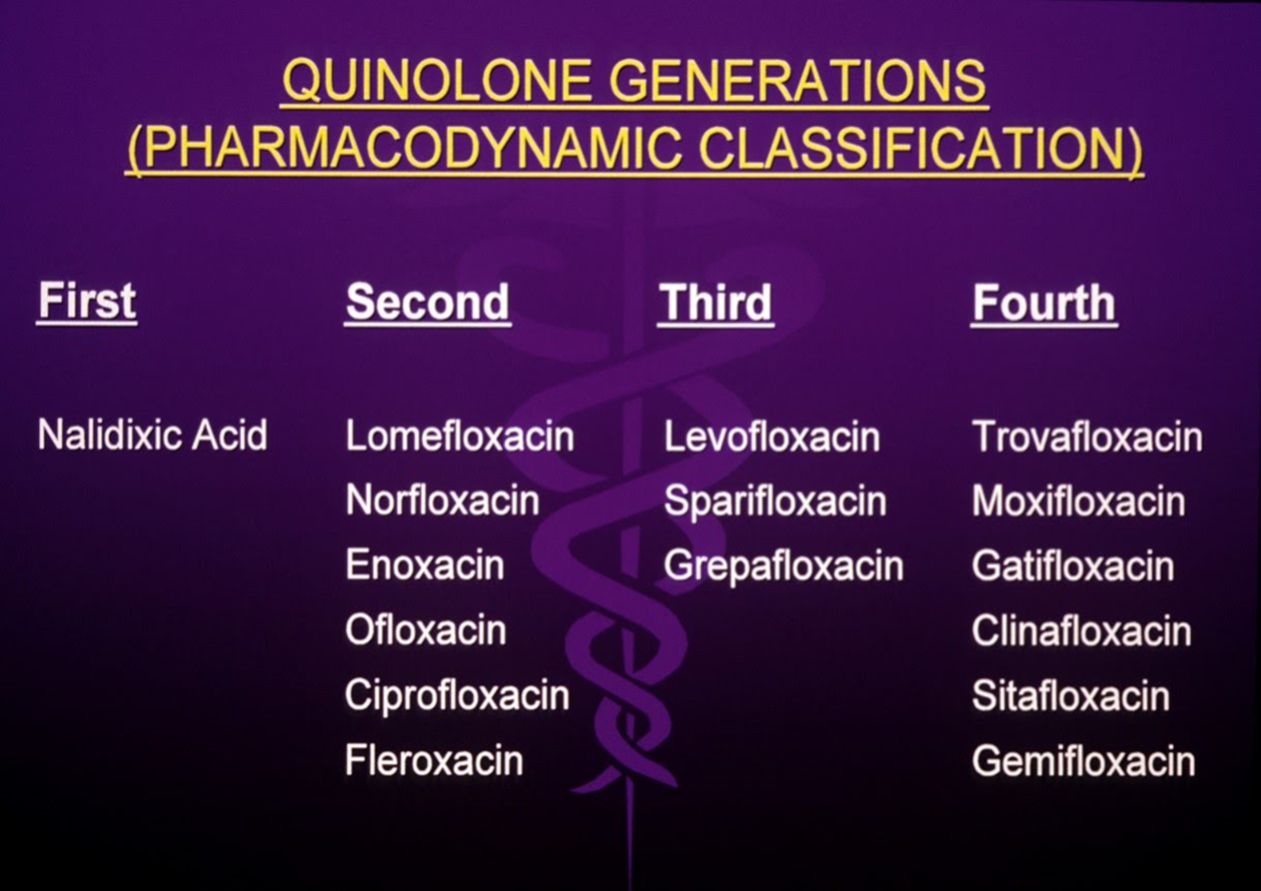

Slide 52
Trimethoprim/sulfamethoxazole or Co-trimoxazole
An antibiotic used in the treatment of a variety of bacterial, fungal and protozoal infections.
Co-trimoxazole is generally considered bactericidal, although its components are individually bacteriostatic.
Its actions are antifolate in nature, inhibiting both de novo folate biosynthesis and metabolism.

Slide 53
Tetracyclines
Broad-spectrum bacteriostatic agents and work by inhibiting the bacterial protein synthesis.
Tetracyclines may be effective against a wide variety of microorganisms, including Rickettsia and Amoebic parasites.
Tetracyclines are used in the treatment of infections of the respiratory tract, sinuses, middle ear, urinary tract, skin, intestines.

Slide 54
Tetracyclines also are used to treat Gonorrhea, Rocky Mountain spotted fever, Lyme Disease, Typhus.
Their most common current use is in the treatment of moderately severe acne and rosacea.
Tetracycline antibiotics are:
  Tetracycline
  Doxycycline (Vibramycin)
  Minocycline
  Oxytetracycline (Oxytetracid)
  Tigacycline

Slide 55
Chloramphenicol
It is a bacteriostatic
It is considered a prototypical broad-spectrum antibiotic, alongside the tetracyclines, and as it is both cheap and easy to manufacture, it is frequently an antibiotic of choice in the developing world.
Effective against a wide variety of Gram-positive and Gram-negative bacteria, including most anaerobic organisms.

Slide 56
Due to resistance and safety concerns, it is no longer a first-line agent for any infection in developed nations, with the notable exception of topical treatment of bacterial conjunctivitis.

Slide 57
Oxazolidinones (e.g. linezolid)
Linezolid inhibits ribosomal protein synthesis by inhibiting formation of the initiation complex.
It is used for the treatment of serious infections caused by Gram-positive bacteria that are resistant to several other antibiotics.
Linezolid is active against most Gram-positive bacteria that cause disease, including streptococci, vancomycin-resistant enterococci (VRE), and methicillin-resistant Staphylococcus aureus (MRSA).

Slide 58
Ansamycins
A family of secondary metabolites that show antimicrobial activity against many Gram-positive and some Gram-negative bacteria and includes various compounds, e.g. streptovaricins and rifamycins
among Rifamycins are a subclass of ansamycins with high potency against mycobacteria. This resulted in their widespread use in the treatment of tuberculosis, leprosy, and AIDS-related mycobacterial infections.

Slide 59
The antibacterial activity of rifamycins relies on the inhibition of bacterial DNA-dependent RNA synthesis. This is due to the high affinity of rifamycins for the prokaryotic RNA polymerase.

Slide 60
Rifaximin is a semisynthetic antibiotic basedon rifamycin. It has poor oral bioavailability, meaning that very little of the drug will be absorbed into the blood stream when it is taken orally. Rifaximin is used in the treatment of traveler's diarrhea and hepatic encephalopathy.
Rifaximin interferes with transcription by binding to the β-subunit of bacterial RNA polymerase.

Slide 61
Metronidazole
A nitroimidazole antibiotic medication used particularly for anaerobic bacteria and protozoa.
It is antibacterial against anaerobic organisms, an amoebicide, and an antiprotozoal.
It inhibits nucleic acid synthesis by disrupting the DNA of microbial cells. This function only occurs when Metronidazole is partially reduced, and because this reduction usually happens only in anaerobic cells, it has relatively little effect upon human cells or aerobic bacteria.

Slide 62
Metronidazole is primarily used to treat: bacterial vaginosis, pelvic inflammatory disease (along with other antibacterials like ceftriaxone), pseudomembranous colitis, aspiration pneumonia, rosacea (topical), fungating wounds (topical), intra-abdominal infections, lung abscess, gingivitis, amoebiasis, giardiasis, trichomoniasis, and infections caused by susceptible anaerobic organisms such as Bacteroides.

Slide 63
It is also often used to eradicate Helicobacter pylori along with other drugs and to prevent infection in people recovering from surgery.
Adverse effects include:
Discolored urine, headache, metallic taste , nausea
Metronidazole is classed as pregnancy category B

Slide 64
Polymyxins
The most popular : Colisitin
Mechanism of Action: Binds to lipopolysaccharides (LPS) and phospholipids in the outer membrane of Gram-negative bacteria.Disrupts membrane integrity, leading to cell lysis and bacterial death.
Active against Gram-negative bacteria only Highly effective against multidrug-resistant (MDR) pathogens, including:Acinetobacter baumanniiPseudomonas aeruginosaKlebsiella pneumoniae

Slide 65
treatment of MDR Gram-negative infections, including:Ventilator-associated pneumonia (VAP)BacteremiaComplicated urinary tract infections (cUTIs)Intra-abdominal infections

Slide 66
Antibiotic Class | Antibiotic Class Members | Most Common Side Effects
Penicillins | penicillin, amoxicillin, amoxicillin-clavulanate, ampicillin, piperacillin-tazobactam, nafcillin, oxacillin | Rash, diarrhea, abdominal pain, nausea/vomiting, drug fever, hypersensitivity (allergic) reactions
Cephalosporins | cephalexin, cefaclor, cefuroxime, ceftibuten, cefdinir, cefixime, ceftriaxone | Rash, diarrhea, nausea/vomiting (rare), hypersensitivity (allergic) reactions, serum sickness,
Carbapenems | meropenem, ertapenem, doripenem, imipenem-cilastatin | Diarrhea, nausea/vomiting, headache, rash, liver toxicity, eosinophilia (elevated white blood cells)

Slide 67
Antibiotic Class | Antibiotic Class Members | Most Common Side Effects
Aminoglycosides | gentamicin, tobramycin, amikacin | Nephrotoxicity, ototoxicity (hearing loss), dizziness, nausea/vomiting, nystagmus
Macrolides | erythromycin, azithromycin, clarithromycin | Abdominal pain, diarrhea, anorexia, nausea/vomiting, hepatotoxicity (erythromycin)
Tetracyclines | tetracycline, doxycycline, minocycline | Nausea/vomiting, diarrhea, sore mouth, abdominal pain, tooth discoloration in children < 8 years, liver toxicity

Slide 68
Antibiotic class | Antibiotic Class Members | Most Common Side Effects
Sulphonamides | trimethoprin-sulfamethoxazole, sulfadiazine | nausea/vomiting, diarrhea, anorexia, abdominal pain, rash, photosensitivity, headache, hemolytic anemia
Lincosamide | clindamycin, lincomycin | Pseudomembranous colitis (may be severe), diarrhea, nausea/vomiting, rash, hypersensitivity, jaundice (clindamycin)
Quinolones | Ciprofloxacin, norfloxacin,levofloxacin | Nausea/vomiting, headache, arthropathy in children,nephrotoxicity

Slide 69
Antibiotic class | Antibiotic Class Members | Most Common Side Effects
Glycopeptides | Vancomycin | Red man syndrome (flushing, hypotension, itching); phlebitis, nephrotoxicity nausea/vomiting, headache, dizziness
Miscellanous | Metronidazole | Nausea/vomiting, dizziness, headache, vaginal candidiasis, metallic taste, peripheral neuropathy, discolored urine
Chloramphenicol | chloramphenicol | Grey baby syndrome, bone marrow aplasia

Slide 70
Antibiotic class | Antibiotic Class Members | Most Common Side Effects
Oxazolidinones | Linezolid | bone marrow suppression and low platelet counts, peripheral neuropathy and optic nerve damage, and lactic acidosis.
Ansamycins | Rifamycins | Nausea/vomiting, abdominal pain, Hepatotoxicity, flushing, pruritus, rash, redness and watering of eyes
Polymyxcin | Colistin | Nephrotoxicity and neurotxicity

Slide 71
Category B | Category C | Category D
Penicillin | Clarithromycin | Aminoglycoside
Cephalosporin | Quinolones | Tetracyclines
Azithromycin, Erythromycin. | Carbapenems | Sulfonamides
Nitrofurantoin (avoid at term) | Vancomycin | Chloramphenicol
Metronidazole

Slide 72
Streptogramins
Effective in the treatment of vancomycin-resistant Staphylococcus aureus (VRSA) and vancomycin-resistant Enterococcus (VRE), two of the most rapidly growing strains of multidrug-resistant bacteria.
Members include:
Quinupristin/dalfopristin
Pristinamycin
Virginiamycin

Slide 73
Adverse effects include:
Related to administration via peripheral vein
Inflammation, pain, edema, infusion site reaction, thrombophlebitis
Non-venous adverse effects
Nausea, vomiting, diarrhea
Rash
Headache
Pain, ill-defined focal or generalized discomfort
Pruritus
Arthralgia, myalgia
Asthenia
Conjugated hyperbilirubinaemia

Slide 74


New drugs
Plazomicin
Eravacycline
Cefiderocol
Antibiotics that combine BL-BLIs Ceftazidime /avibactam
Ceftolozane /tazobactam
Meropenem /vaborbactam, Imipenem-cilastatin / relebactam.
Temocillin only approved in Belgium and the United Kingdom

Slide 75
Plazomicin
Brand name (Zemdri)
Mechanism of action : A synthetic aminoglycoside, Inhibits bacterial protein synthesis.
Used in complicated urinary tract infections (cUTIs ) and pyelonephritis (FDA approved in 2018 ) .
Side effects : possibility of nephrotoxicity and ototoxicity
Activity : plazomicin is active against > 95% of Enterobacterales isolates , against ESBL isolates, and against carbapenem-resistant isolates

Slide 76
Eravacycline
Brand name ( Xerava )
Mechanism of action A fluorocycline of the tetracycline class ,it inhibits bacterial protein synthesis.
Used in treatment of cIAI at for a total duration of 4 to 14 days . (FDA approved in 2018 )
In Egypt ( Nuzyra = Omadacyclin )
Side effects : as other tetracyclines, permanent tooth discoloration may occur .
Activity : against E. coli , K. pneumoniae - Acinetobacter spp and CRE isolates .

Slide 77
Temocillin
Brand name Negaban ; Temopen
Mechanism of action Temocillin is a semisynthetic derivative of ticarcillin , a penicillin antibiotic targeting penicillin-binding protein (PBP3) , inhibiting the synthesis of the peptidoglycan layer of bacterial cell wall .
Used in alternative to carbapenems treating infections due to ESBL-producing Enterobacterales and uncomplicated UTI due to Klebsiella pneumoniae Carbapenemase producers .
Side effects as injectable penicillins , pain at the site of I.M. injection, occasionally urticarial rash .
Activity against ESBL, and carbamenase producing Enterobacterales .

Slide 78
Cefiderocol
Brand name (Fetroja)
Mechanism of action : a novel combination of a catechol-type siderophore and a cephalosporin antibiotic , binding to and inhibiting penicillin-binding proteins (PBPs) ,this structure enhanced stability against hydrolysis by many β-lactamases
Used in treatment of cUTI, (FDA approved in 2019 ) and this indication was extended to HAP/VAP in 2020.
Side effects infusion site reactions, candidiasis, cough, elevations in liver tests, hypokalaemia, hypomagnesemia, and atrial fibrillation.
(Cefiderocol has FDA label warning for higher mortality versus other antibiotics in critically ill patients with multidrug-resistant Gram-negative bacterial infections)
Activity against of Enterobacterales isolates (ESBL) , Acinetobacter spp. and P. aeruginosa isolates including those which are carbapenem-resistant .

Slide 79
Beta-Lactam/Beta-Lactamase Inhibitor
These antibiotics are a combination of a cephalosporin or a carbapenem antibiotic with a beta-lactamase inhibitor (BLI).
Mechanism of action inhibiting beta-lactamases, the partner beta-lactam antibiotic is allowed to reach its target, the penicillin-binding proteins (PBPs).

Slide 80
Ceftazidime/Avibactam
Brand name (Avycaz)
Used in treating complicated intra abdominal infections ( cIAI) (in combination with metronidazole) and cUTI ( FDA approvedin 2015 ) extended to HAP/VAP in 2018.
Side effects positive direct Coombs test.
Activity against Gram-negative bacteria producing ESBL, carbapenem non susceptible and P. aeruginosa .
In Egypt ( Zavicefta)
Used in complicated intra-abdominal infections (cIAI); Complicated urinary tract infections (cUTI), including pyelonephritis; hospital-acquired pneumonia (HAP), including ventilator associated pneumonia (VAP)

Slide 81
Ceftolozane/Tazobactam
Brand name (Zerbaxa)
It is an anti-pseudomonal cephalosporin partnered with BLI tazobactam.
Used in : cUTI and cIAI.( FDA approved in 2014) .The indication was extended to HAP/VAP in 2019.
Activity against ESBL Enterobacterales and carbapenem non susceptible P. aeruginosa .

Slide 82
Meropenem/Vaborbactam
Brand name (Vabomere)
Used in FDA approved to treat cUTI at a dose of 4 g (meropenem 2 g and vaborbactam 2 g) .
Side effects occurring in 3% of patients were phlebitis /infusion-site reactions .
Activity against carbapenem resistence Enterobacterales ( CRE)

Slide 83
Imipenem-Cilastatin/Relebactam
Brand name ( Recarbrio)
Used in cUTI and cIAI (FDA approved in 2019) (imipenem 500 mg, cilastatin 500 mg, and relebactam 250 mg). The indication was extended to HAP/VAP in 2020.
Side effects elevated lever enzymes, increased eosinophils, rash.
Activity against Enterobacterales (including ESBL) and P. aeruginosa , K. pneumoniae isolates producing carbamenases.
Because imipenem is rapidly inactivated by renal dehydropeptidase I (DHP-1), it is given in combination with cilastatin, a DHP-I inhibitor which increases half-life and tissue penetration of imipenem

Slide 84
For more information:
http://www.emedexpert.com/classes/antibiotics.shtml
http://en.wikipedia.org/wiki/List_of_antibiotics
http://www.orthobullets.com/basic-science/9059/antibiotic-classification-and-mechanism
http://www.nlm.nih.gov/medlineplus/antibiotics.html
https://www.youtube.com/channel/UCvl8mk9dKfhidf8oVhYkaOg

Slide 85


